Slide 1
APP 19.8 Automatic Karyotyping of Chromosomes
Reference :
An efficient transportation algorithm for
automatic chromosome karyotyping

Slide 2
Outline
Application introduction
Mathematical formulation
Transportation problem

Slide 3
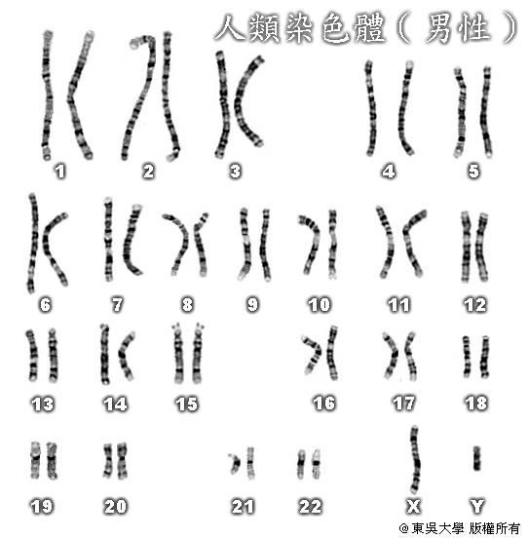
Application introduction
Karyotyping (染色體核型分析)
This is an important clinical tests, since the identification of abnormalities in chromosomes of particular groups may be diagnostic of certain clinical syndromes, such as amniocentesis (羊膜穿刺).
A normal human cell has 46 chromosomes, usually subdivided into 23 groups.
a) Each group contains two identical
chromosomes, with the exception
of sex chromosomes groups.
b) Sex chromosomes groups
- Female has XX
- Male has XY

Slide 4
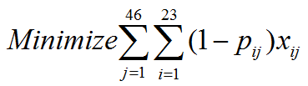
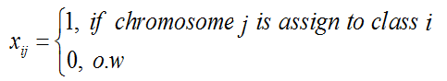
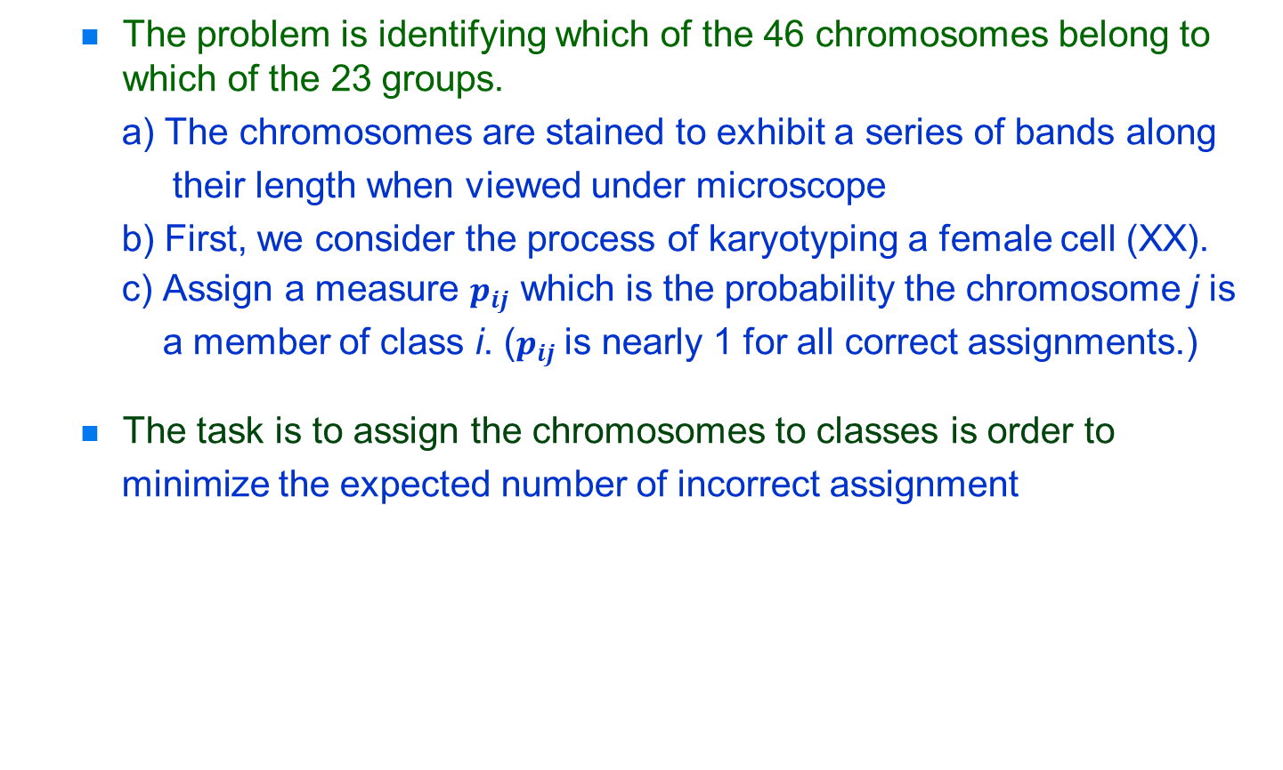
The problem is identifying which of the 46 chromosomes belong to which of the 23 groups.
a) The chromosomes are stained to exhibit a series of bands along
their length when viewed under microscope
b) First, we consider the process of karyotyping a female cell (XX).
c) Assign a measure $p_{ij}$ which is the probability the chromosome j is
a member of class i. ($p_{ij}$is nearly 1 for all correct assignments.)
The task is to assign the chromosomes to classes is order to
minimize the expected number of incorrect assignment

Slide 5

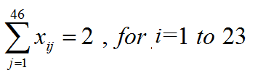
Mathematical formulation
Objective
Constraint
Each chromosome is assigned once only.
Precisely two chromosomes are assigned to each group.

Slide 6
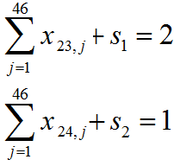
Now, we consider the process of karyotyping a male cell (XY).
a) Add a dummy chromosome 47.
b) Add a dummy group 24 which represent Y group.
c) Define the additional binary variables
d) Add two additional constraints

Slide 7
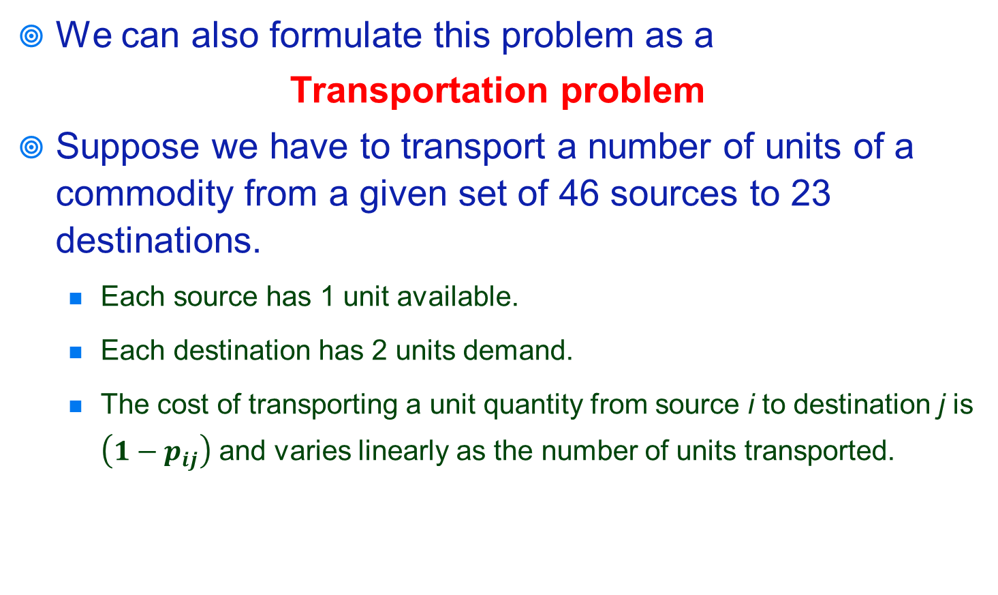
Transformation
We can also formulate this problem as a
Transportation problem
Suppose we have to transport a number of units of a commodity from a given set of 46 sources to 23 destinations.
Each source has 1 unit available.
Each destination has 2 units demand.
The cost of transporting a unit quantity from source i to destination j is $\left(1−p_{ij}\right)$ and varies linearly as the number of units transported.

Slide 8


Transportation problem
Chromosome
Group
Ex : Female
Objective
Constraint
$cost=\left(1−p_{ij}\right)$
1
1
1
-2
1
2
2
-2
1
3
3
-2
1
4
4
-2
1
5
…...
…...
23
-2
1
46

Slide 9




Ex : Female & Male
Objective
Constraint
a. When S₁=0 ; S₂=1 ➔ ; = 0
Chromosome
Group
$cost=\left(1−p_{ij}\right)$
1
1
1
-2
1
2
2
-2
1
3
3
-2
1
4
4
-2
1
5
…...
…...
46
23
-2
1
47
24
-1
1

Slide 10

b. When S₁=1 ; S₂=0 ➔ ; = 1
Chromosome
Group
$cost=\left(1−p_{ij}\right)$
1
1
1
-2
1
2
2
-2
1
3
3
-2
1
4
4
-2
1
5
…...
…...
23
-2
1
46
47
24
-1
1

Slide 11
Reference
Tso, M., P. Kleinschmidt, I. Mitterreiter and J. Graham. An efficient transportation algorithm for automatic chromosome karyotyping. Pattern Recognition Letters 12, 117-126. 1991.

